Slide 1

Hotel Reservation Cancellation Prediction
Research and Modeling by
Thanos Chronopoulos
Andreas Gabriel
Filippos Georgiopoulos

Slide 2
Dataset characteristics
Data Partitioning Approach
Initial Size:
120K Rows, 30 Columns
Classes:
1: 44224
0: 75166
Dataset Division:
90% → Model Development Set
Used for training and validation
10% → Completely Unseen Data
Reserved for final evaluation
Integrated into our Streamlit application
Inside the 90% Development Set:
Train/Test split: 80% / 20%
5-Fold Cross-Validation
Stratified splitting

Slide 3
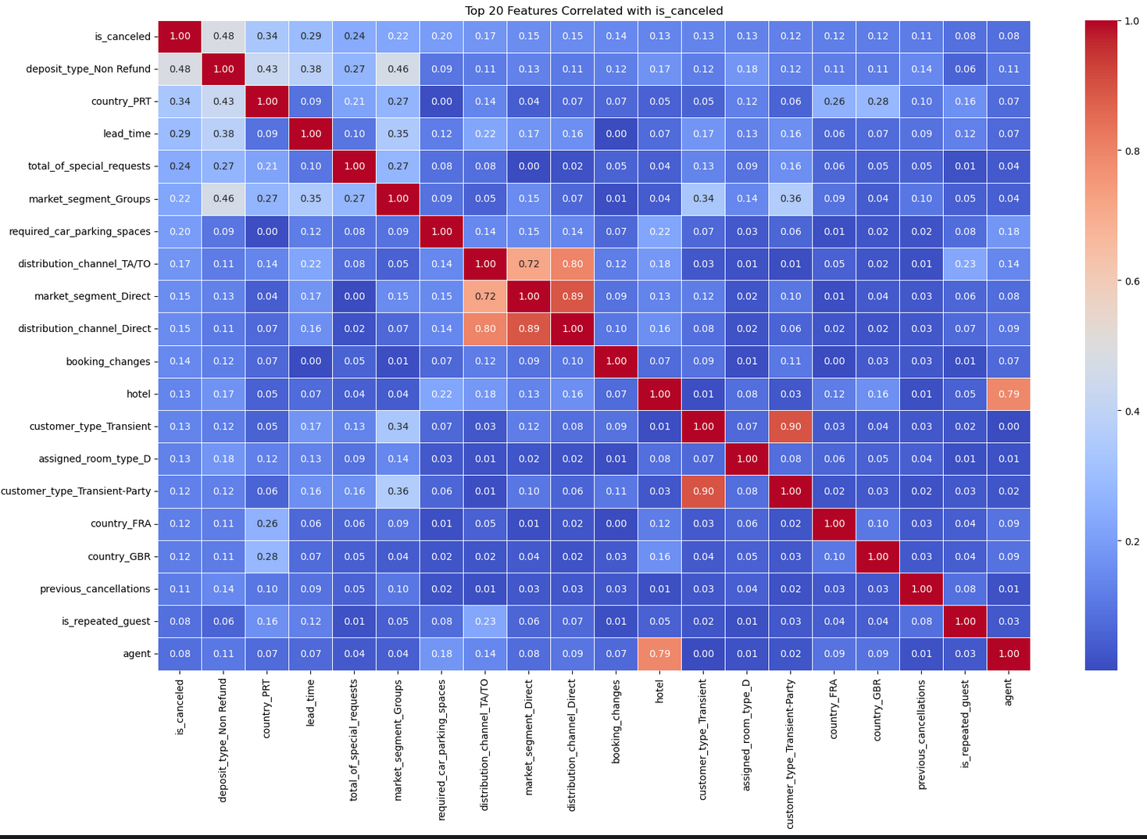
correlation heatmap

Slide 4
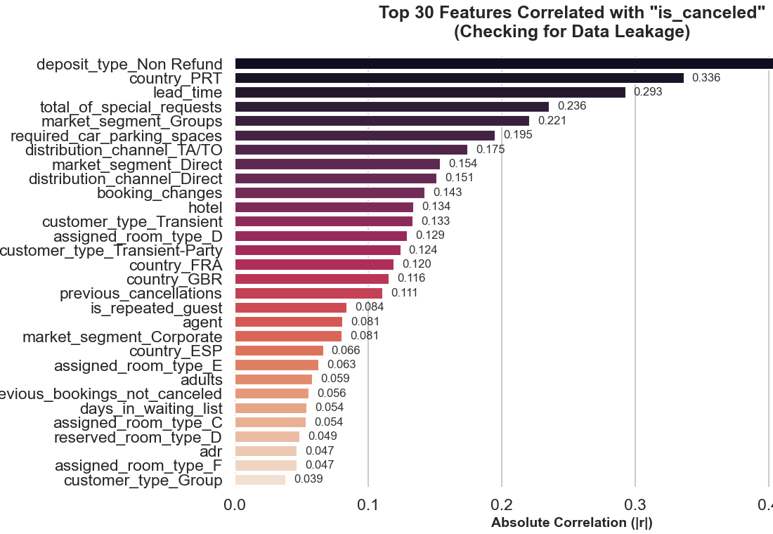
Feature correlations

Slide 5
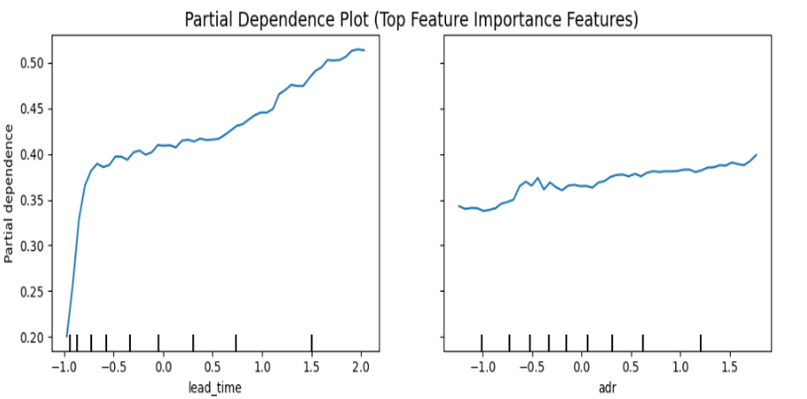
Correlations with the target variable

Slide 6
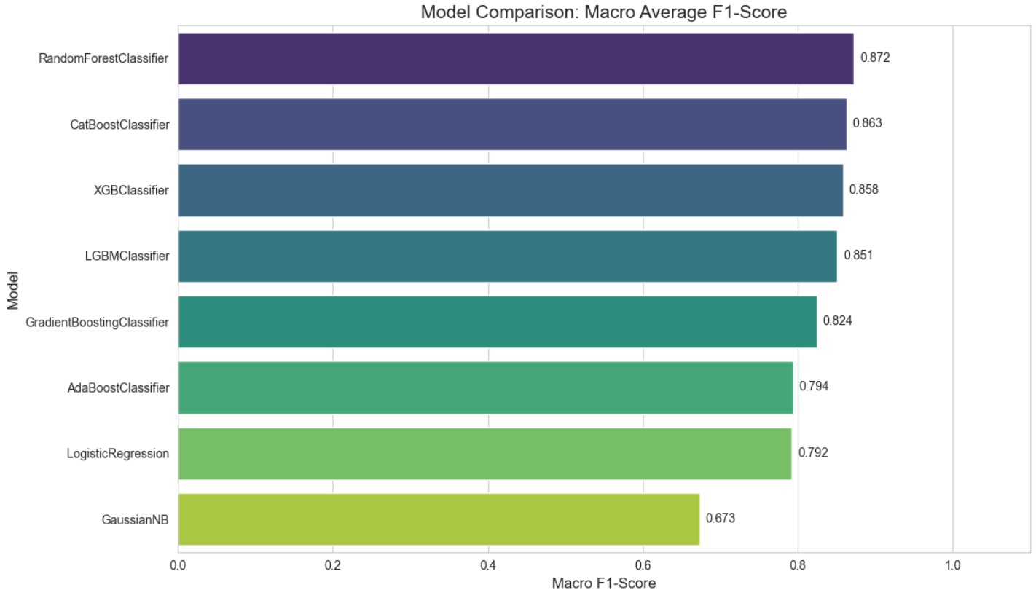
Baseline model performance randomforest, catboost and xgboost are the top performers

Slide 7
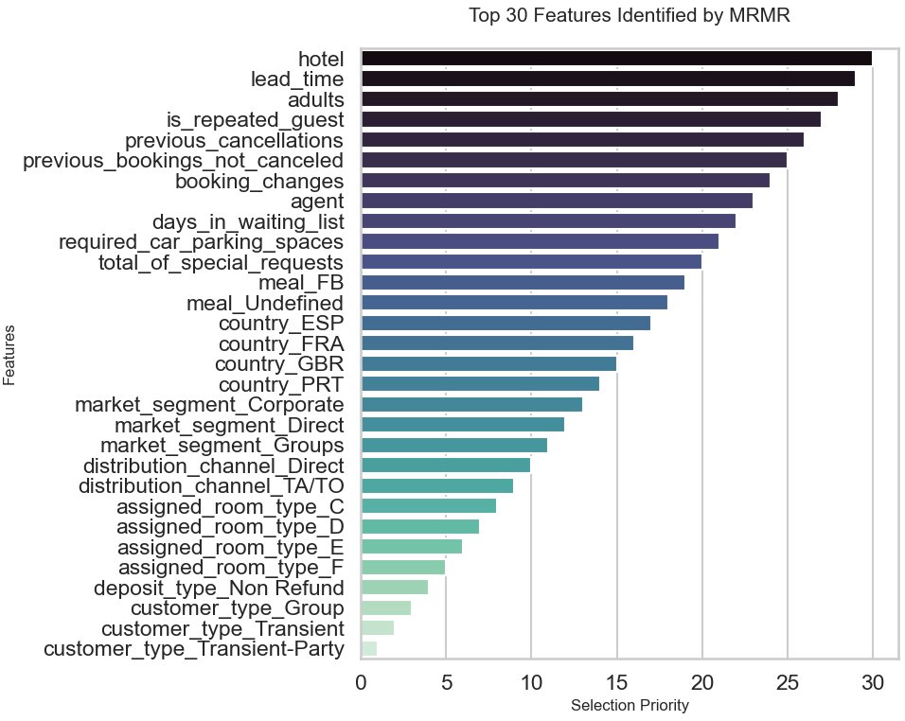
Top 30 Features Retained by MRMR

Slide 8
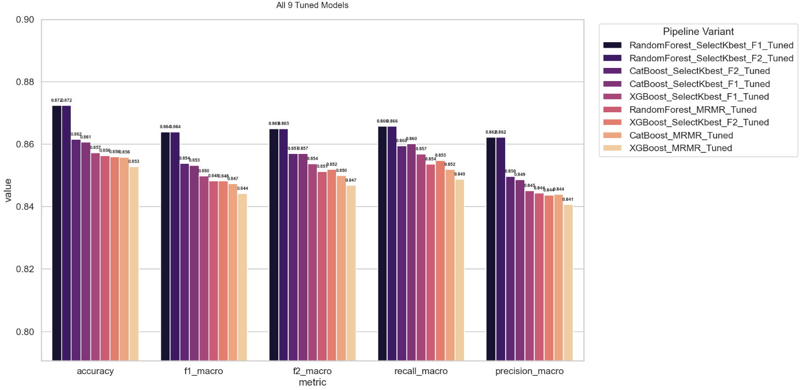
Compare all 9 Tuned models
We have selected the Random Forest F1-Tuned and the CatBoost F2-Tuned as the two champion models to offer the business distinct operational modes:
The Random Forest F1 is the most robust choice for automated systems, ensuring that guests are not incorrectly flagged and inconvenienced by "False Alarms".
The CatBoost F2 serves as an aggressive "Safety Net" for revenue protection. It is optimized to minimize missed cancellations, making it ideal for proactive outreach or inventory overbooking during high-demand periods.

